Slide 1
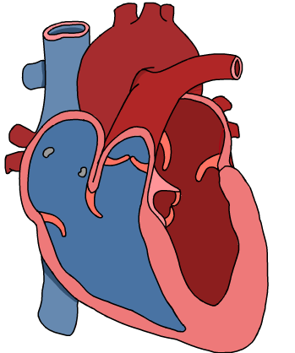
11ATAR Biology
Week 33
Transport Systems In Animals

Slide 2

Year 11 Biology Work Schedule
It is important to remain on schedule during this Semester.
Moodle
Have you visited Moodle this week? Yes / No
Tasks
Are you on schedule? Yes / No
When is your next task due?
U2T4 Topic Test
On Topic 4 – Multicellular Organisms
62 marks / 60 min
Multiple choice/short answer/1 Extended Answer

Slide 3
Review
State two characteristics of all gas exchange surfaces in animals.
Identify the main gas exchange surface of mammals.

Slide 4
Learning Intentions
Describe the structure and function of animal circulatory systems.
Success Criteria
Students will be able to:
Explain the structure of open and closed circulatory systems.
Describe the structure and function of the heart, blood vessels and blood according to the different metabolic requirements of organisms and differing environments.

Slide 5
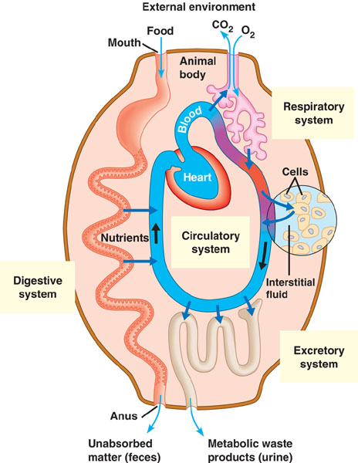
Transport System
We need a system which can pick up and deliver the supplies to all the cells. The system also needs to be able transport all the wastes from the cells to get expelled.
This transport system is the circulatory system.
The circulatory system is also important for other functions such as maintenance of body temperature, the immune response and hormonal control of bodily functions.
Notes:
The respiratory (gas exchange) system and digestive system get the required molecules, nutrients and fuel into the body and remove the waste products from the body.

Slide 6
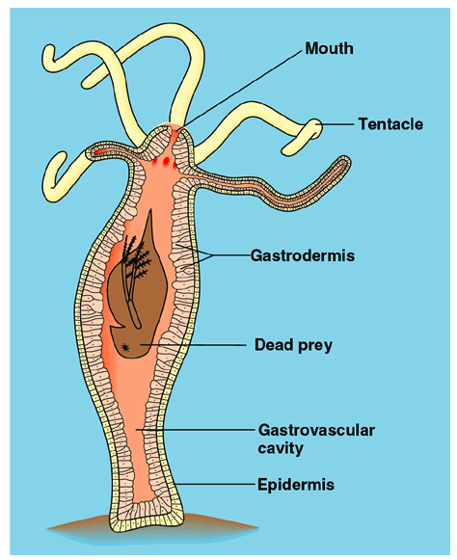
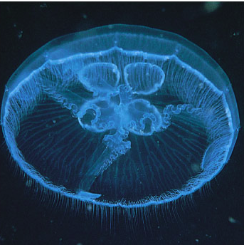
Simple Organisms
When your body is only two-cell layers thick, you can get supplies in and waste out just through diffusion.
Jellyfish
Hydra

Slide 7
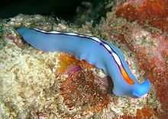
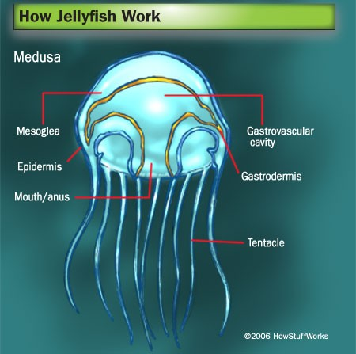
Simple Organisms
Flatworms - every cell is able to obtain nutrients, water and oxygen without the need of a transport system.
The flatworm's flattened body shape also restricts the distance of any cell from the digestive system or the exterior of the organism. Oxygen can diffuse from the surrounding water into the cells, and carbon dioxide can diffuse out.
Some animals, such as jellyfish, have more extensive branching from their gastrovascular cavity (which functions as both a place of digestion and a form of circulation). This branching allows for bodily fluids to reach the outer layers, since the digestion begins in the inner layers.
Notes:
The flatworms body cavity has no lining or enclosed fluid. Instead a muscular pharynx leads to a branched digestive system that allows direct diffusion of nutrients to all cells. The flatworm's flattened body shape also restricts the distance of any cell from the digestive system or the exterior of the organism. Oxygen can diffuse from the surrounding water into the cells, and carbon dioxide can diffuse out.
Gastrovascular cavity has single opening (mouth/anus) (1)
Alimentary canal is one-way system with separate mouth/anus (1)

Slide 8
Complex Organisms
Complex organisms need a circulatory system to deliver the materials where they are needed.
The main system all complex animals have is called the cardiovascular system.
The cardiovascular system is made up of three parts -
    Heart
    Blood vessels which includes the:
    Blood

Slide 9
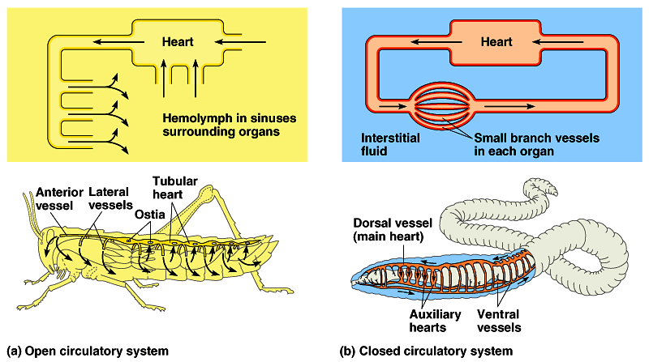
Cardiovascular Systems
Animal cardiovascular systems have: -
  A muscular pump = heart
  Tubes = blood vessels
  Circulatory fluid = blood
open
closed
hemolymph
blood
Notes:
Insect blood, properly called hemolymph, flows freely through the body cavity and makes direct contact with organs and tissues.
The insect circulation system does not carry oxygen, so the blood does not contain red blood cells as ours does. Hemolymph is usually green or yellow.

Slide 10
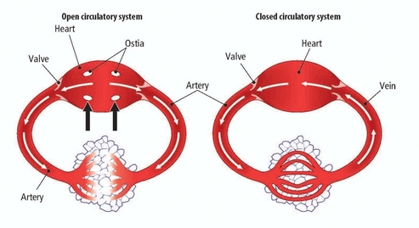
Types of Cardiovascular Systems
In animals these are classified as either open or closed systems.
Closed circulatory systems have the blood enclosed at all times within vessels of different size and wall thickness. In this type of system, blood is pumped by a heart through vessels, and does not normally fill body cavities.
Open circulatory systems pump blood into a haemocoel (main body cavity of invertebrates) with the blood diffusing back to the circulatory system between cells. Blood is pumped by a heart into the body cavities, where tissues are surrounded by the blood.
Insects have a cavity that is full of insect blood (known as haemolymph) and the organs of the insect are suspended in this cavity.
Notes:
The haemocoel is the main body cavity of invertebrates, such as insects. Insects do not possess an arrangement of blood vessels such as those in mammals. Instead insects have a cavity that is full of insect blood (known as haemolymph) and the organs of the insect are suspended in this cavity.

Slide 11
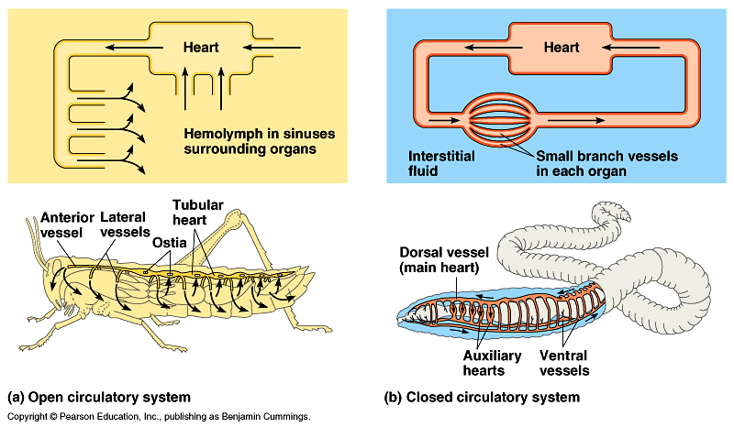
Open Circulatory System
Found in invertebrates (insects, arthropods, molluscs)
Structure -
  Blood does not remain enclosed in the blood vessels and comes in direct contact with other body cells and bathes them.
  There are no typical arteries, veins, and capillaries and for much of the time the blood called haemolymph surrounds the cells.
  This system does not transport gases like oxygen and carbon dioxide.
Advantages of an open system:
  Requires less energy expenditure to operate.
  Can serve other functions. For example, in molluscs the open circulatory system functions as a hydrostatic skeleton in supporting the body.

Slide 12
Closed Circulatory System
Found in invertebrates such as earthworms, squid, octopuses and all vertebrates.
Structure: -
  Blood always remains in the blood vessels and does not come in direct contact with other cells of the body. Blood confined to vessels and separate from tissue fluid.
  One or more hearts to pump blood.
  Interconnected system of arteries, veins, and capillaries present.
  Exchange of nutrients and waste products between the blood and tissue via tissue fluid occurs at the capillaries.
  The system also transports gases, ie. oxygen and carbon dioxide.
Advantages: -
  Closed systems, with their higher blood pressure, are more effective at transporting circulatory fluids to meet the high metabolic demands of the tissues and cells of larger and more active animals.
  Allows animals to control blood flow to different organs as necessary.

Slide 13
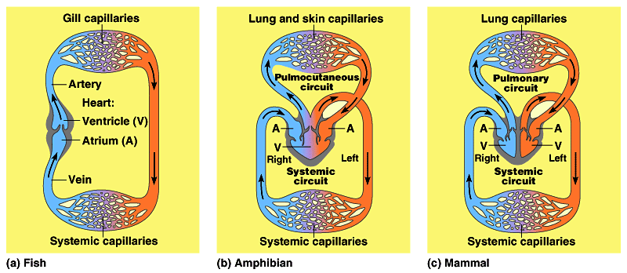
Vertebrate Cardiovascular Systems
Vertebrates have a chambered heart
  Atrium, which receives blood.
  Ventricle which pumps blood out.
In vertebrates the number of chambers differ. Some only have two, some three and some four.

Slide 14
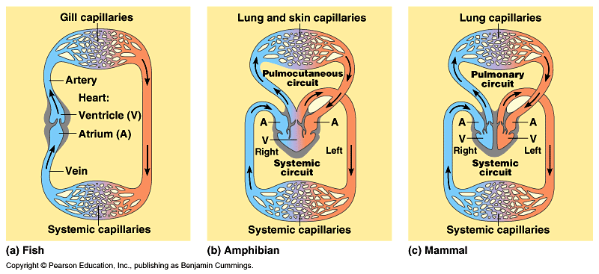
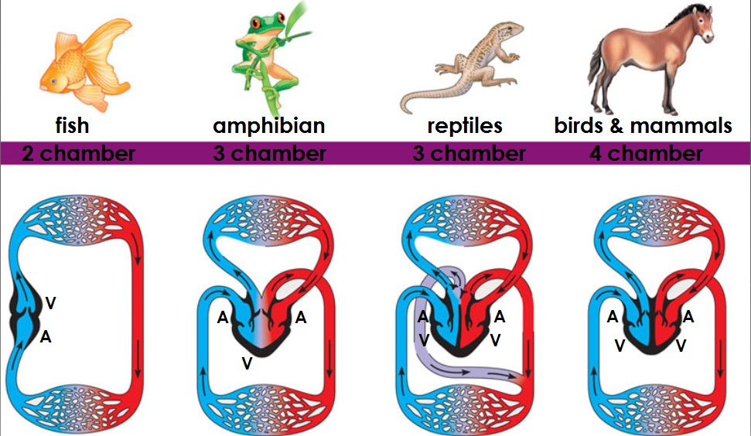
Vertebrate Cardiovascular Systems
A powerful four–chambered heart was an essential adaptation in support of life of mammals and birds. Endotherms use about ten times as much energy as equal–sized ectotherms. Therefore, their circulatory systems need to deliver about ten times as much fuel and O₂ to their tissues (and remove ten times as much CO₂ and other wastes).
This large traffic of substances is made possible by separate and independent systemic (body) and pulmonary (lung) circulations and by large, powerful hearts that pump the necessary volume of blood.

Slide 15
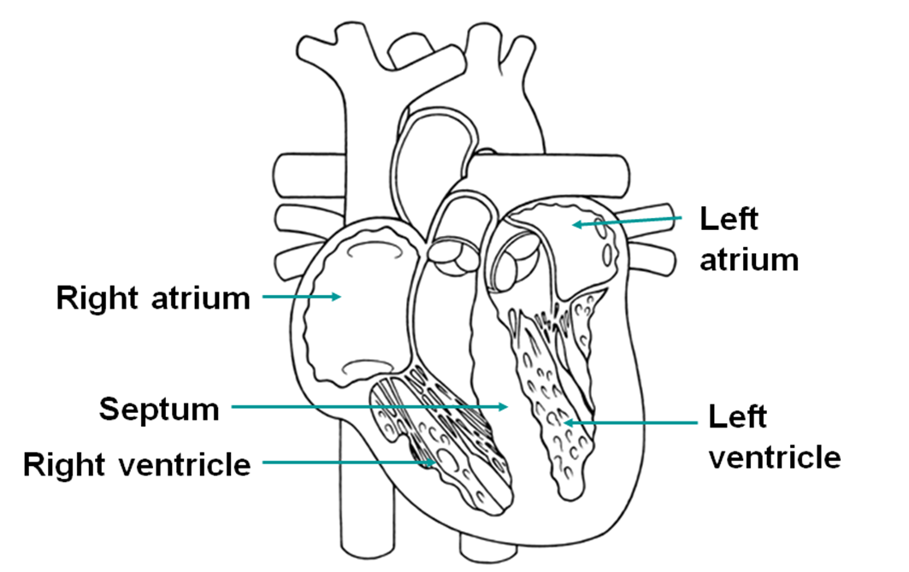
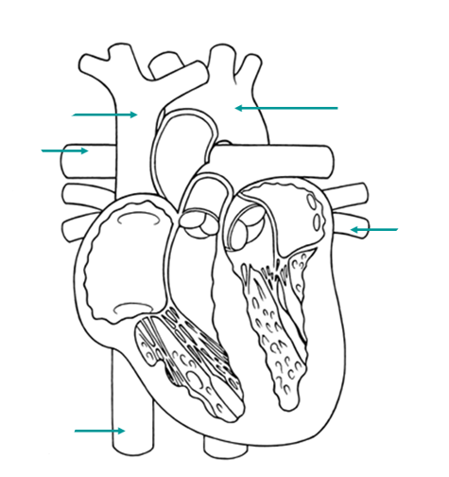
Mammalian Heart

Slide 16
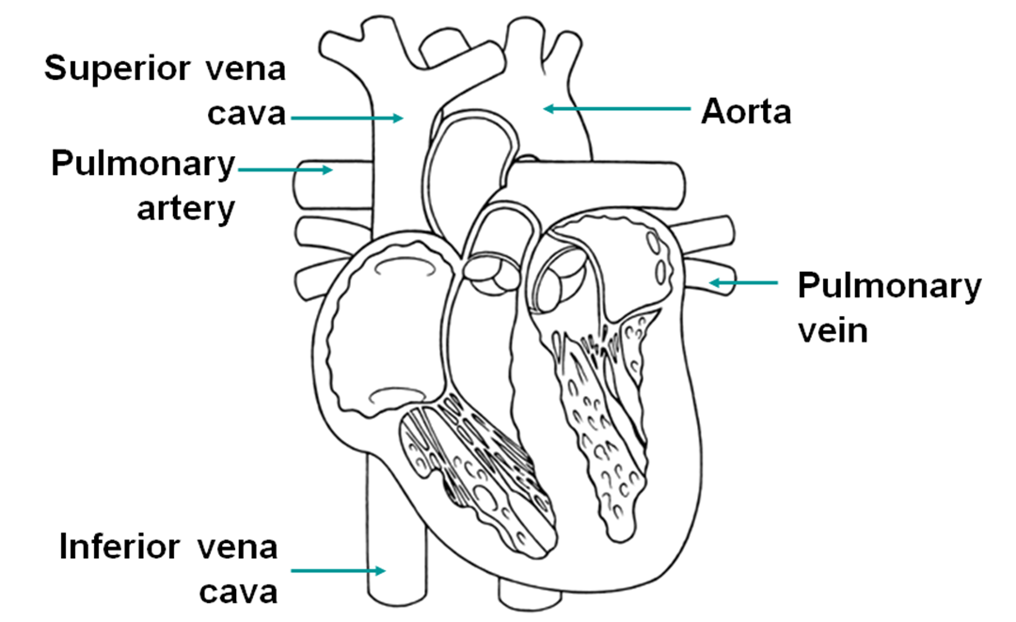
Mammalian Heart

Slide 17
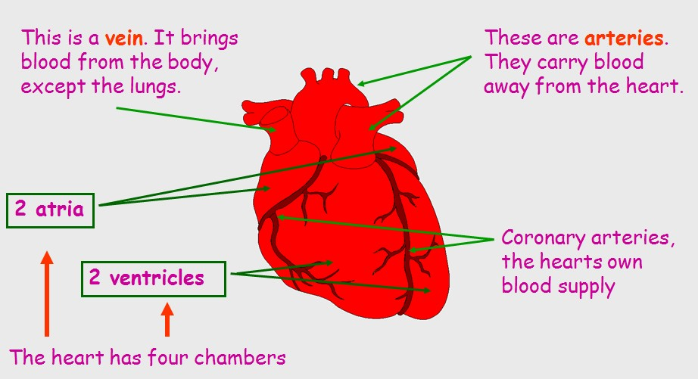
Mammalian Heart
Must watch video of a heart dissection
https://www.youtube.com/watch?v=-vsHgj1f0XE

Slide 18
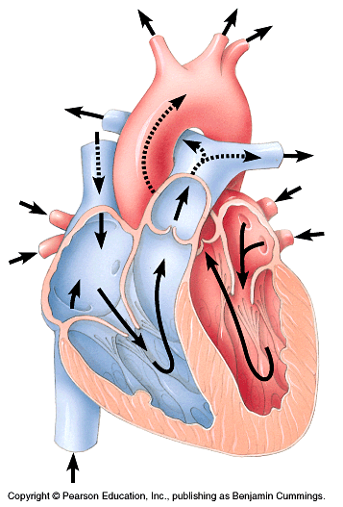
Heart Valves
There are four valves in the heart. These are flaps of connective tissue which prevent backflow of blood.
Atrioventricular (AV) valve
  between atrium & ventricle
  keeps blood from flowing back
  into atria when ventricles contract
Semilunar valves
  between ventricle & arteries
  prevent backflow from arteries into ventricles while they are relaxing
The heart sounds heard with a stethoscope are caused by the closing of the valves. (Even without a stethoscope, you can hear these sounds by pressing your ear tightly against the chest of a friend—a close friend.)
SL
AV
AV
Notes:
The sound pattern is “lub–dup, lub–dup, lub–dup.” The first heart sound (“lub”) is created by the recoil of blood against the closed AV valves. The second sound (“dup”) is the recoil of blood against the semilunar valves.

Slide 19
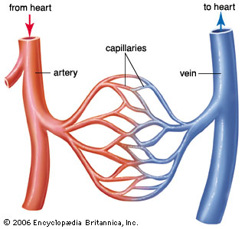
Blood Vessels
Blood vessels
  Arteries = carry blood away from heart. Smaller arteries are called arterioles.
  Veins = return blood to heart. Smaller veins are called venules.
  Capillaries = deliver blood to cells and connect arteries and veins.
Arteries, veins, and capillaries are the three main kinds of blood vessels, which in the human body have a total length of about 100,000 km.
All arteries carry blood from the heart toward capillaries, and veins return blood to the heart from capillaries. One exception is the hepatic portal vein that carries blood from capillary beds in the digestive system to capillary beds in the liver. Blood flowing from the liver passes into the hepatic vein, which conducts blood to the heart.
Notes:
One exception is the hepatic portal vein that carries blood from capillary beds in the digestive system to capillary beds in the liver. Blood flowing from the liver passes into the hepatic vein, which conducts blood to the heart.

Slide 20
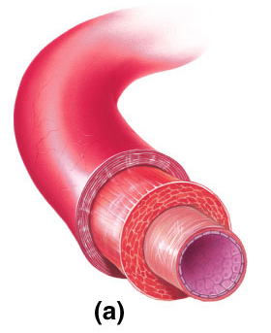
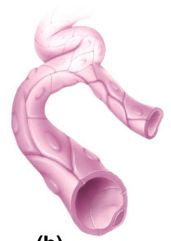
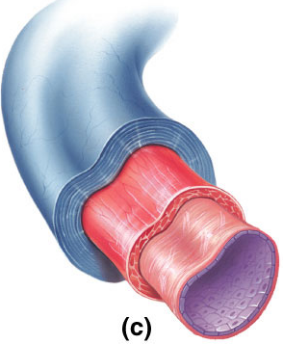
Blood Vessels
arteries
veins
artery
arterioles
venules
arterioles
capillaries
venules
veins

Slide 21
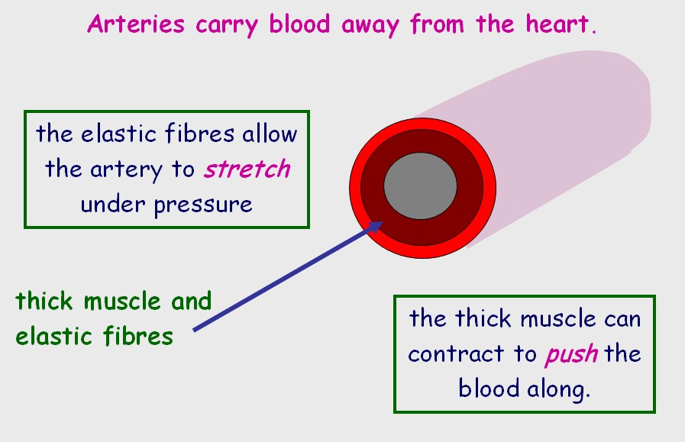
Blood Vessels - Arteries

Slide 22
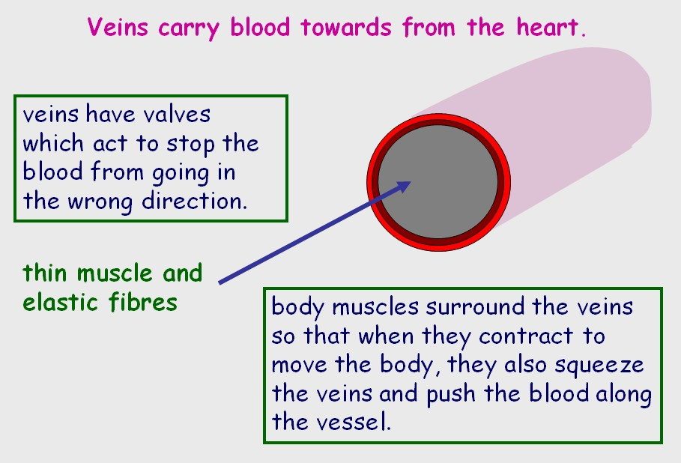
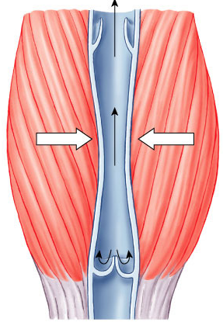
Blood Vessels - Veins
Blood flows
toward heart
Open valve
Closed valve

Slide 23
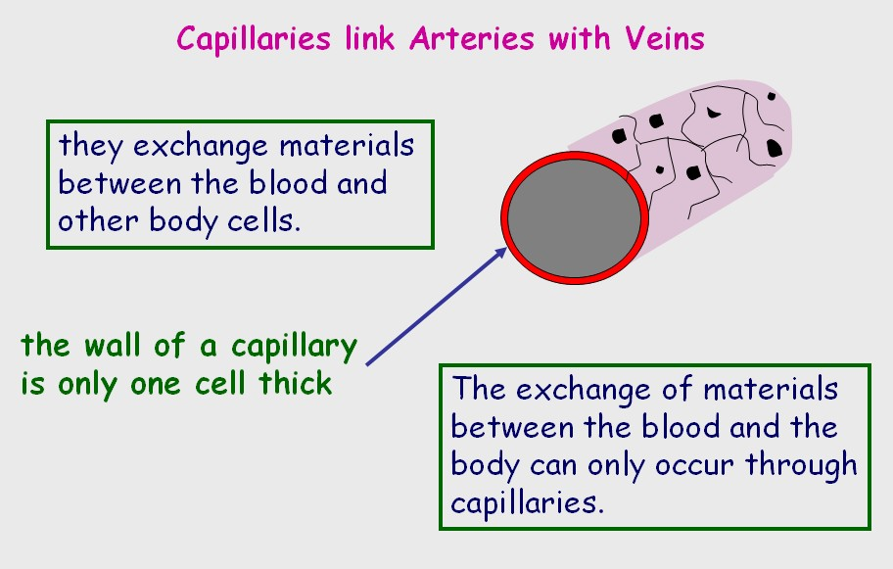
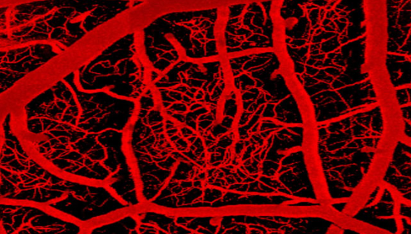
Blood Vessels - Capillaries

Slide 24
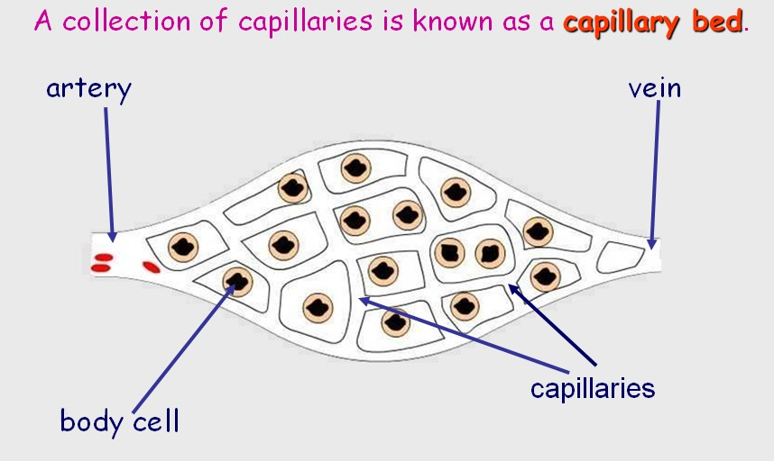
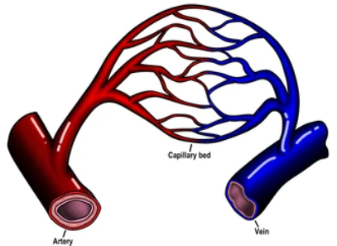
Blood Vessels - Capillary Bed

Slide 25
Lesson 2…

Slide 26
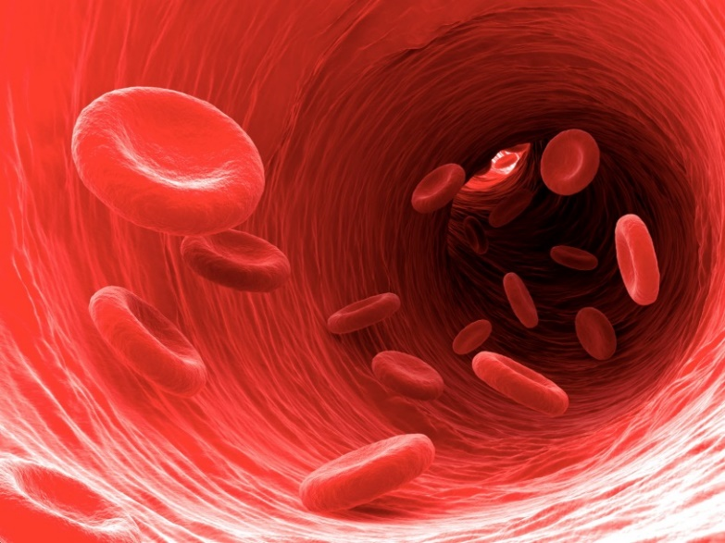
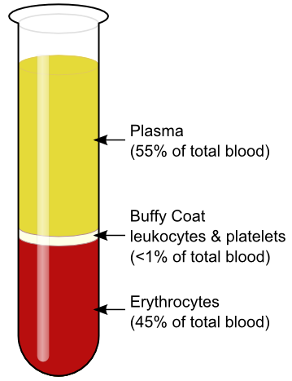
Blood
The average 70 kg human has about 5 L of blood.
Approximately 55% of the blood is liquid, called the plasma; the remaining 45% is composed of blood cells, including erythrocytes (red blood cells), leucocytes (white blood cells) and platelets.
The blood cells are considered to be a tissue because they are cells that work together for a common cause.

Slide 27
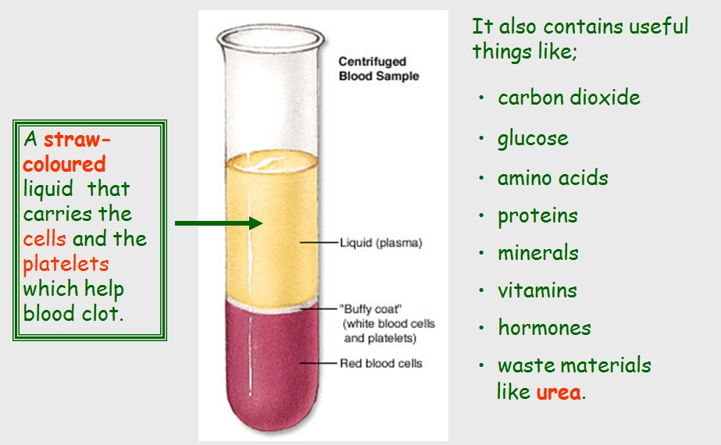
Blood – Plasma

Slide 28
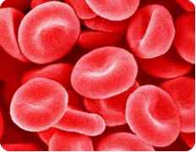
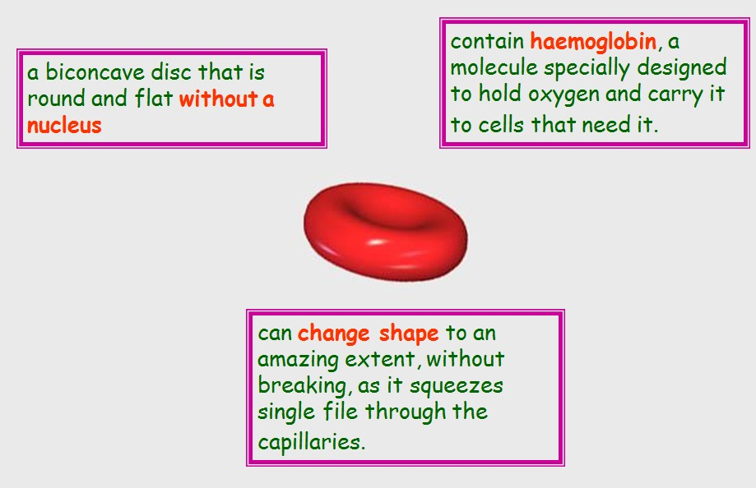
Blood – Red Blood Cells
(Erythrocytes)

Slide 29
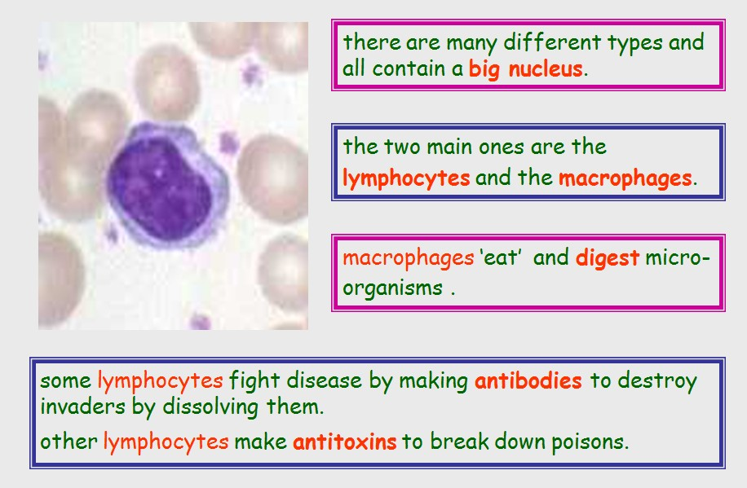
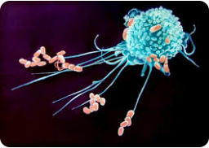
Blood – White Blood Cells
(Leukocytes)
Macrophage engulfing bacteria

Slide 30
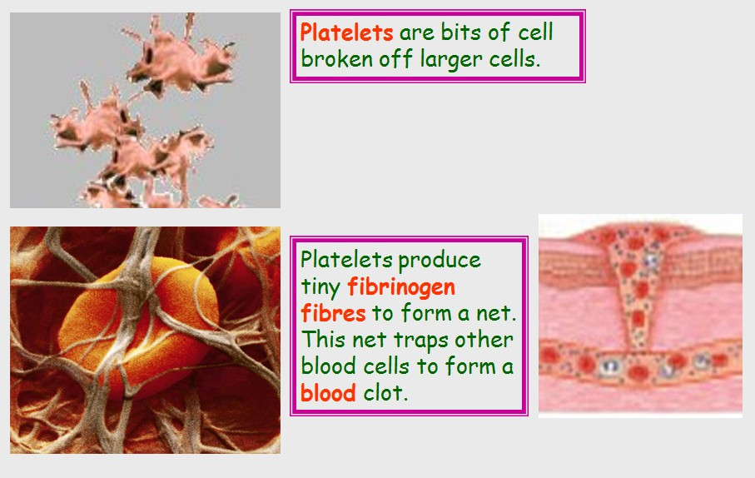
Blood - Platelets

Slide 31
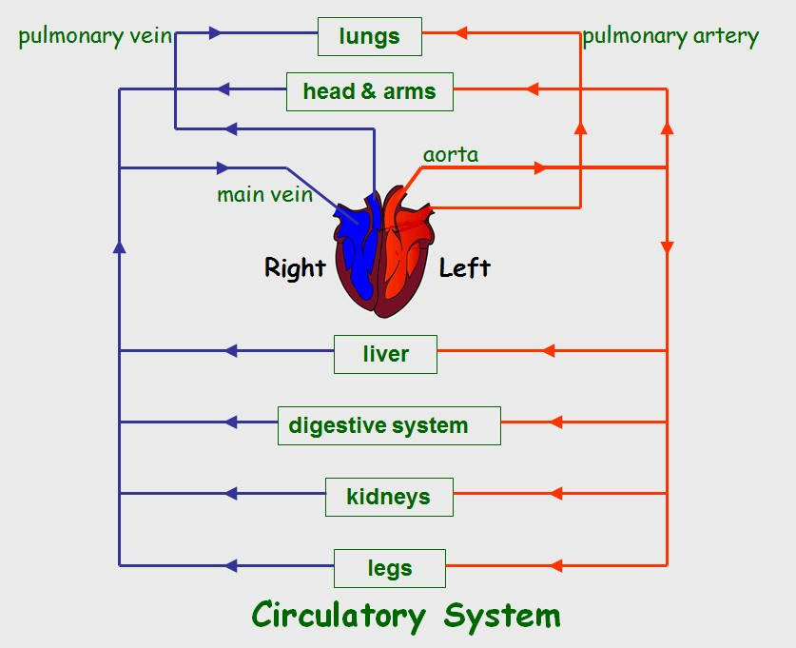
Mammalian Circulation
The heart, blood vessels and blood all work together to circulate the required materials around the body.

Slide 32
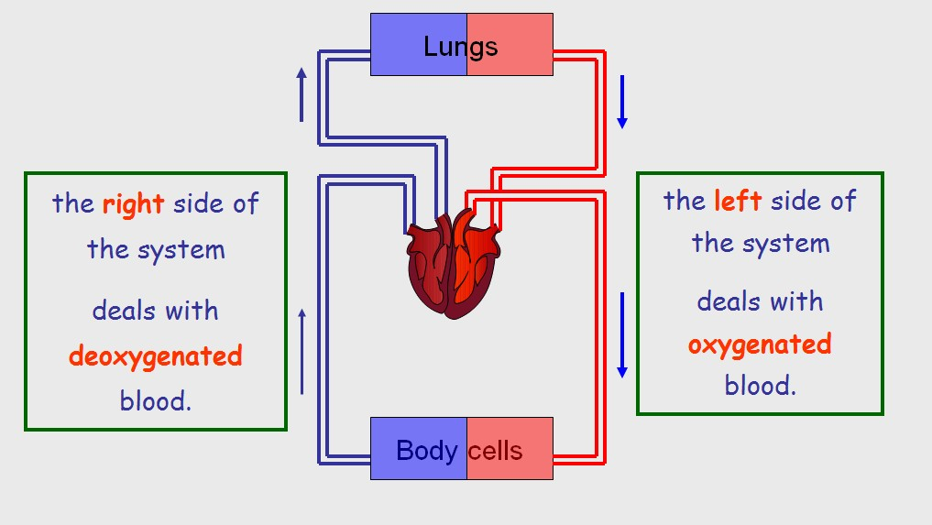
Mammalian Circulation
There are two circulation loops – one pulmonary to the lungs and one systemic to the rest of the body

Slide 33
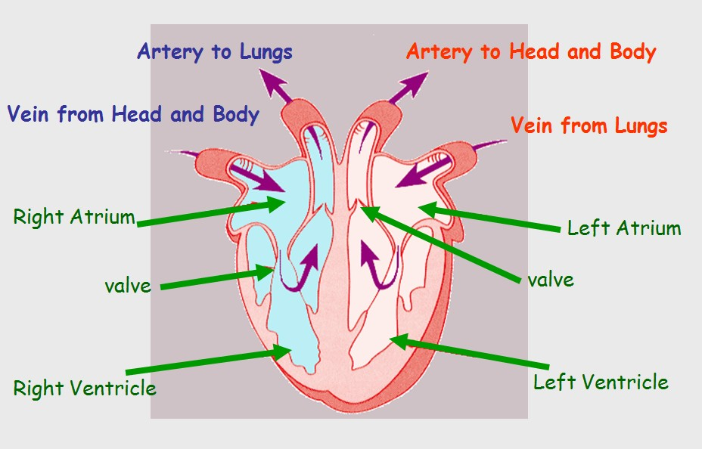
Steps in Mammalian Circulation
Deoxygenated blood enters the right atrium, via the vena cava, from the systemic loop (coming from the body system) of blood and passes into the right ventricle.
Right atrium contracts and pumps blood into right ventricle.
When the right ventricle contracts, blood is forced into the pulmonary artery, which leads to the lungs (pulmonary loop). This is called pulmonary circulation.

Slide 34
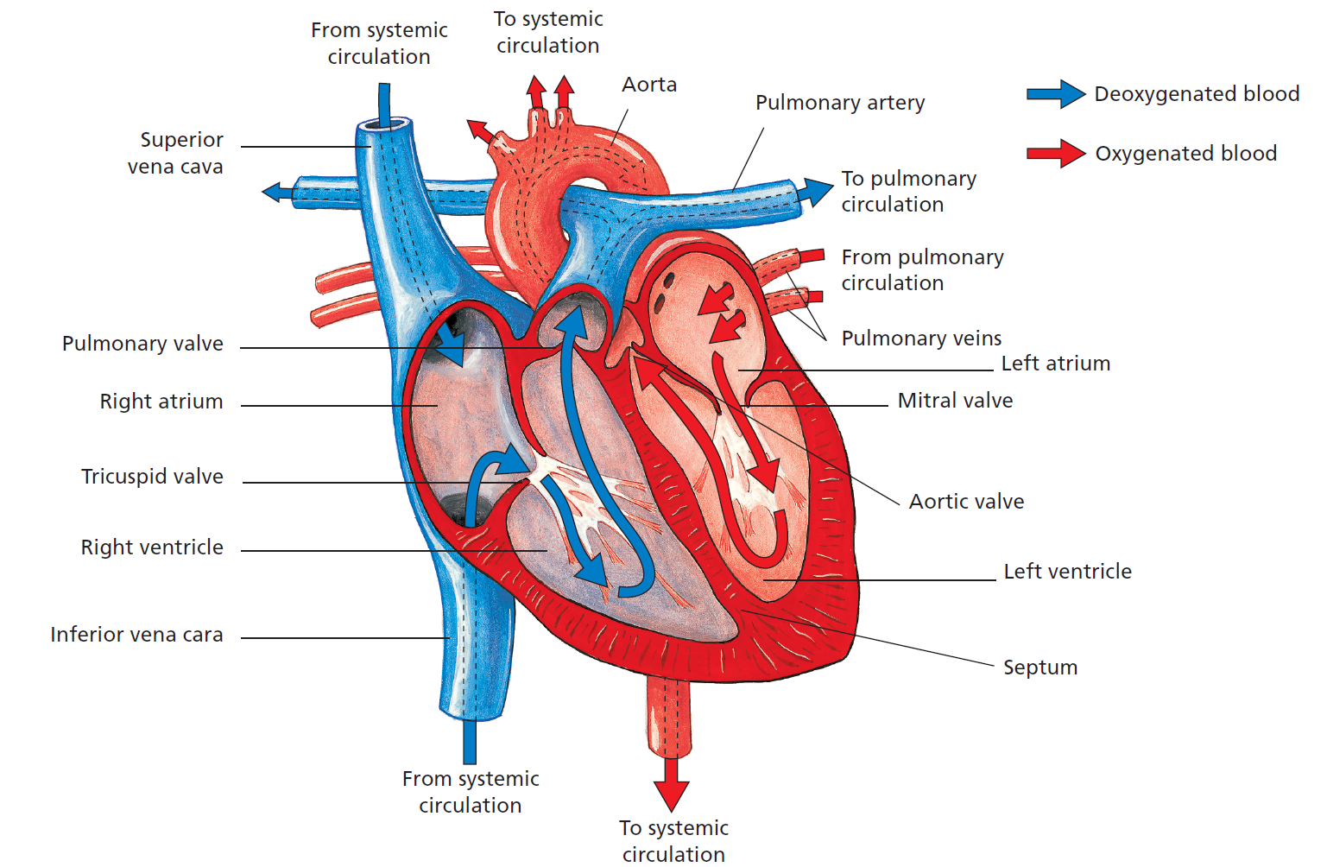
Steps in Mammalian Circulation
In the lungs, oxygen diffuses into the blood and carbon dioxide passes out into the air in the lungs.
The now oxygen-rich or oxygenated blood passes back into the heart via the pulmonary veins and into the left atrium.
The left atrium contracts and pumps blood into the left ventricle.
When this ventricle contracts, the blood is forced into the aorta, the largest artery, which, through its many branches, takes blood to all parts of the body. This is called systemic circulation.

Slide 35
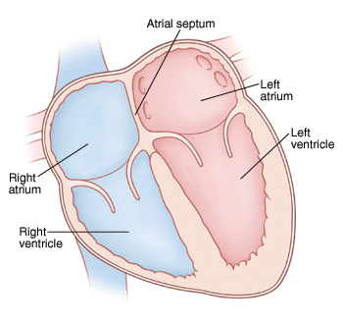
Steps in Mammalian Circulation
The blood is kept flowing in one direction in the heart by the presence of four valves.
The two ventricles contract at the same time and the atria contract at the same time, but the ventricles and atria contract at different times.
The septum keeps the deoxygenated blood on the right side of the heart from mixing with the oxygenated blood on the left side.
Video animation of blood flow through the heart https://www.youtube.com/watch?v=JA0Wb3gc4mE

Slide 36
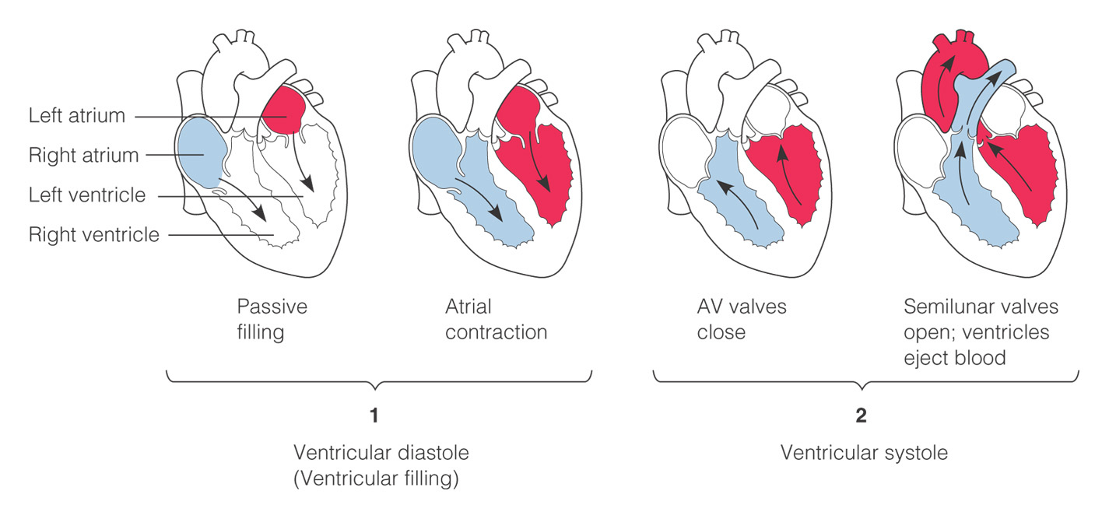
Cardiac Cycle
One complete sequence of pumping of the heart is called the cardiac cycle.
  heart contracts & pumps
  heart relaxes & chambers fill
Contraction phase is called systole.
Relaxation phase is called diastole.
https://www.youtube.com/watch?v=o3UA-bTbWDc
Notes:
Repeating pattern of contraction and relaxation

Slide 37
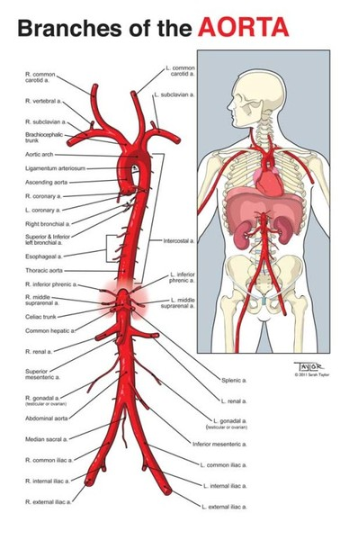
Blood Delivery - Aorta
Oxygenated blood leaving the heart in the aorta is sent to all parts of the body.
The aorta divides and branches off into numerous smaller arteries and arterioles.
Eventually all the branches deliver blood to every body cell at the capillary level.

Slide 38
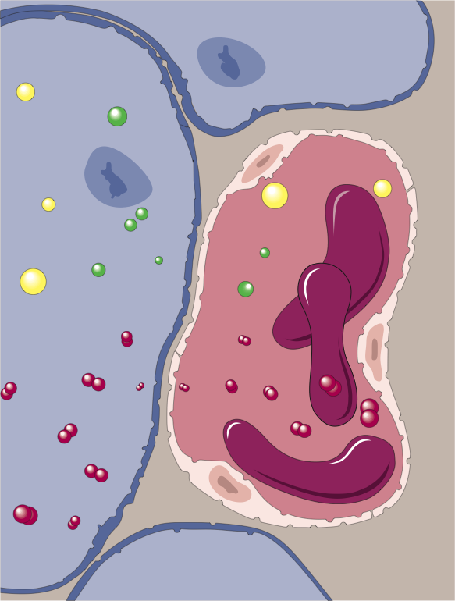
Exchanges in the Capillaries
Tissue cell
Once the blood has reached the capillaries, fluid leaks from capillaries through small gaps where cells join.
The fluid (called tissue fluid) bathes the tissues supplying nutrients and oxygen.
No cell is more than 25 µm away from a capillary.
Capillary walls are thin enough to allow all the exchanges of materials between tissue and blood cells to take place.
Wastes
RBC
Nutrients
Oxygen
Capillary
Tissue fluid
Tissue fluid leaks from the capillaries. Nutrients and wastes are exchanged across the capillary wall, traveling through the tissue fluid.
Notes:
Interstitial fluid is the body fluid between blood vessels and cells, containing nutrients from capillaries by diffusion and holding waste products discharged out by cells due to metabolism.

Slide 39
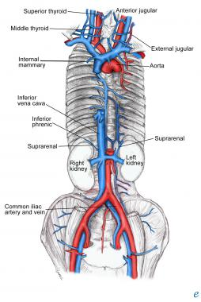
Returning Blood – Vena Cava
Upon leaving the capillary beds, blood now travelling in the veins makes its way back to the heart.
Venules and veins ultimately combine to form the largest vein in the body – the vena cava.
The vena cava empties blood back into the heart at the right atrium.

Slide 40
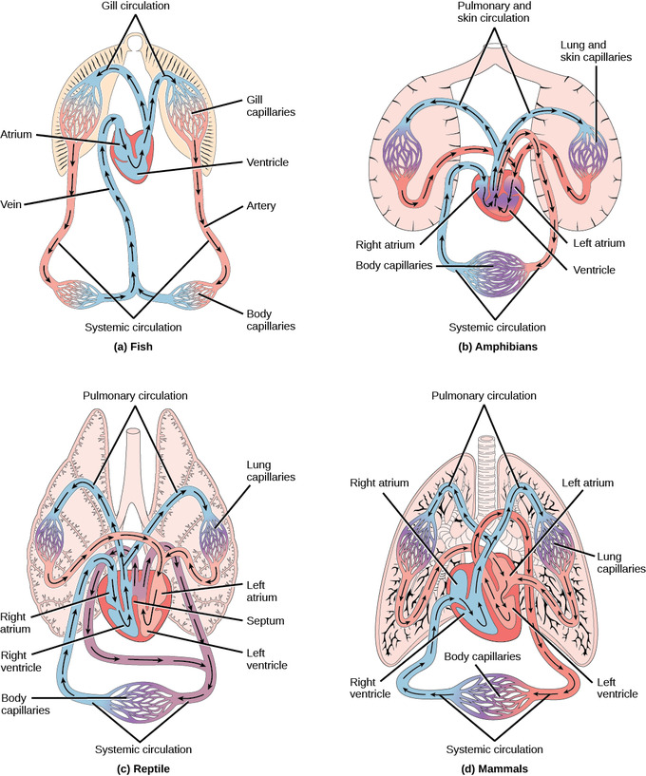
Other Vertebrate Systems
All vertebrates have closed circulatory systems.

Slide 41
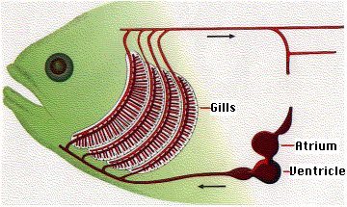
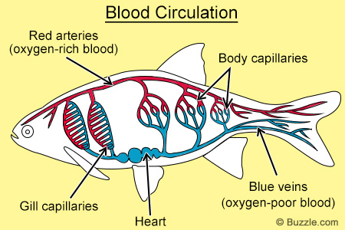
Fish Circulatory Systems
Fish have a single circuit for blood flow and a two-chambered heart that has only a single atrium and a single ventricle.
The atrium collects blood that has returned from the body, while the ventricle pumps the blood to the gills where gas exchange occurs and the blood is re-oxygenated; this is called gill circulation.
The blood then continues through the rest of the body before arriving back at the atrium; this is called systemic circulation.

Slide 42
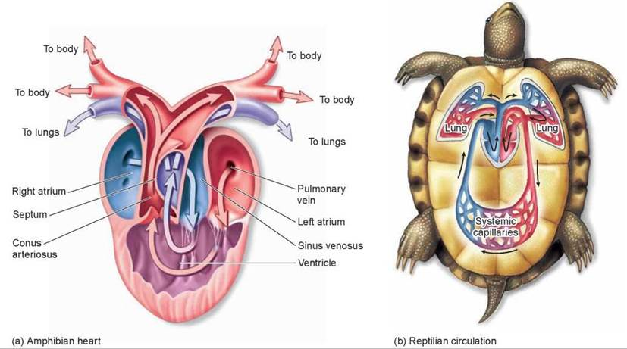
Amphibians and Reptile Systems
In amphibians, reptiles, birds, and mammals, blood flow all have the two-loop pattern (double) of circulation.
Amphibians have a three-chambered heart that has two atria and one ventricle. The two atria receive blood from the two different circuits (the lungs and the systems). There is some mixing of the blood in the heart's ventricle, which reduces the efficiency of oxygenation. The mixing is reduced by a ridge within the ventricle that diverts oxygen-rich blood through the systemic circulatory system and deoxygenated blood to the pulmocutaneous circuit.
Most reptiles also have a three-chambered heart similar to the amphibian heart that directs blood to the pulmonary and systemic circuits. The ventricle is divided more effectively by a partial septum, which results in less mixing of oxygenated and deoxygenated blood. Some reptiles (alligators and crocodiles) are the most primitive animals to exhibit a four-chambered heart.

Slide 43
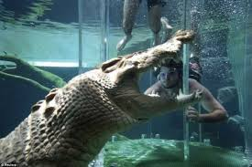

Crocodile Circulation
Crocodilians have a unique circulatory mechanism where the heart shunts blood from the lungs toward the stomach and other organs during long periods of submergence; for instance, while the animal waits for prey.
One adaptation includes two main arteries that leave the same part of the heart: one takes blood to the lungs and the other provides an alternate route to the stomach and other parts of the body.
Two other adaptations include a hole in the heart between the two ventricles, called the foramen of Panizza, which allows blood to move from one side of the heart to the other, and specialized connective tissue that slows the blood flow to the lungs.
Together, these adaptations have made crocodiles and alligators one of the most successfully-evolved animal groups on earth.
Notes:
When crocodilians are digesting a meal, they choose to shunt and direct CO₂-rich blood straight to the stomach where glands make use of the CO₂ to form gastric acid and bicarbonate. Consequently this shunt enables crocodilians to secrete gastric acid at a rate that is approximately 10 times the highest rates measured in mammals. If crocodilians are deprived of this ability to sidestep their lungs, their rates of acid secretion drop significantly and their ability to dissolve bone, a regular part of their normal diet, is impaired.
Concealed below the water's surface, crocodilians stealthily approach animals that have come to drink, spring upon their prey, and drag them into the water and drown them. This powerful burst of activity generates an extraordinary amount of lactic acid in their muscles, which, unless cleared rapidly from the body, can be lethal. The shunting of this acidic blood past the lungs and to the stomach allows the acid to quickly leave the blood and provides the blood with bicarbonate, an important buffer.
It means that blood does NOT have to unnecessarily flow to the lungs when the crocodilian is underwater. The heart rate can fall to just 2–3 beats/minute, thus saving energy in the form of reduced cellular respiration. This same adaptation is interestingly also linked to efficient digestion. Oxygen-rich blood is also carried to areas of the body that need it the most.

Slide 44

Success Criteria
Students will be able to:
Explain the structure of open and closed circulatory systems.
Describe the structure and function of the heart, blood vessels and blood according to the different metabolic requirements of organisms and differing environments.

Slide 45

Exam Review Question
Notes:
Type 1: Single-circuit (one way flow, and heart has only one atrium and one ventricle) E.g. Fish
Type 2: Double circulation E.g. Mammals

Slide 46
Exam Review Question
Insects such as grasshoppers have an open circulatory system. What does this mean?
Outline two (2) benefits of having a closed circulatory system
Notes:
Transport system where transport liquid (haemolymph) is washed freely over internal organs (1) instead of being enclosed in vessels as in a closed system (1).
Delivers oxygen and nutrients directly to cells.
Allow animals to control blood flow to different organs as necessary.
Allows oxygenated and deoxygenated blood fluids to be kept separate for greater efficiency.

Slide 47

Moodle & Textbook Work
Nelson Chapter 12
Revise for test!
And EXAM!

Slide 48
Student Feedback
What I learnt today…..
What I need to revise….

